Slide 1

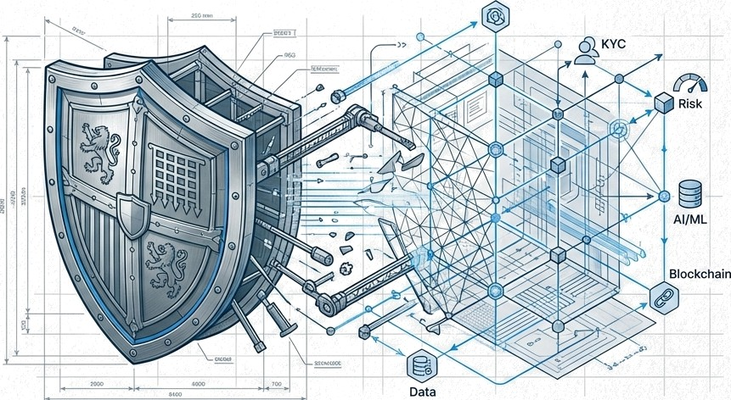
The Evolution Integrity
Navigating AML/CFT Compliance, De-Risking, and the Shift to Perpetual KYC
AML/CFT
PREPARED FOR FINANCIAL COMPLIANCE STRATEGY LEADERS.

Slide 2
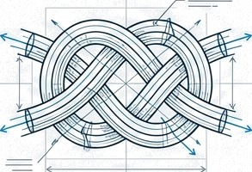
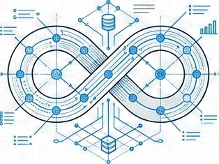

From Static Compliance to Dynamic Integrity
The Mandate The Friction
The Solution
European regulators (NBB, DNB) demand robust, risk-based AML/CFT frameworks that do not compromise financial inclusion.
Traditional ’tick-box' compliance is failing. It creates operational bottlenecks, talent shortages, and leads to categorical
’de risking’ rather than true risk
management.
Moving from periodic review to Perpetual KYC (pKYC)—leveraging data and technology to ensure continuous compliance and operational efficiency.

Slide 3
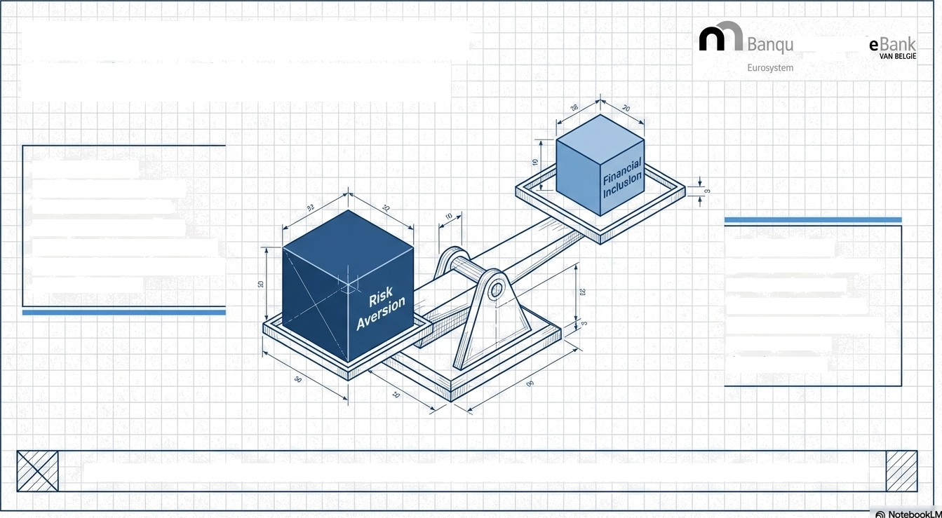
The ‘De-Risliing’ Dilemma: A Failure of Management.
National
OE 8ELGf§UE
NBB Warning:
De-risking—refusing business based on category rather than individual risk—suggests “ineffective management” of ML/FT risks.
Societal Duty: Banks must balance AML duties with Financial inclusion, Contractual freedom, and Economic development.
“Rejection without individual assessment is a sign of inadequate implementation of AML obligations.”

Slide 4

Five Operational Challenges Stifling Financial Institutions
5. Obsolete Methods: The urgent need to move from periodic reviews to pKYC.
1. Negative Experience: Onboarding takes up to 100 days; 13a of corporates switch banks due to friction (Thomson Reuters).
4. Regulatory Flux:
6AMLD and increasingly
stringent rules.
2. Outreach Friction: Inefficient email exchanges and lack of alignment on requirements.
3. Talent Shortage: 156 of workforce in KYC; shortage of skilled analysts

Slide 5



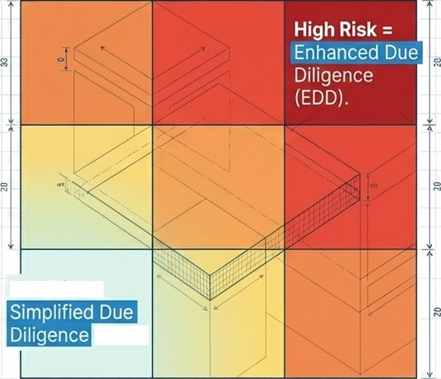
The Risk-Based Approach (RBA). One Size Does Not Fit
26
Core Principle: Institutions determine mitigation strategies based on their own risk assessment.
The Reality: “Residual risk” is accepted;
zero risk is impossible.
- DNB Good Practice: Classify customers based on characteristics (sector, geography, product) to apply appropriate diligence measures.
Low Risk =
(SDD).
Likelihood
G NotebookLM

Slide 6
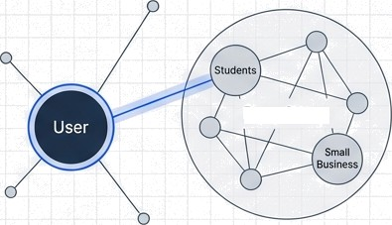




Customer Due Diligence: Beyond the Check-Box.
Identity (Static). Nature (Contextual).
Peer Group
Identity must be verified through reliable, independent
sources.
Name-number check (e.g., 1 cent transfer) is insufficient
on its own.
Purpose & Nature: Understanding WHY the relationship
exists.
Technique: Use Reference Groups to determine if behavior fits the standard profile (e.g., "Students", “Small Business").
DNB Good Practice: Remote Identification solutions require specific policies detailing which steps are autonomous vs human intervention.
G NotebookLM

Slide 7
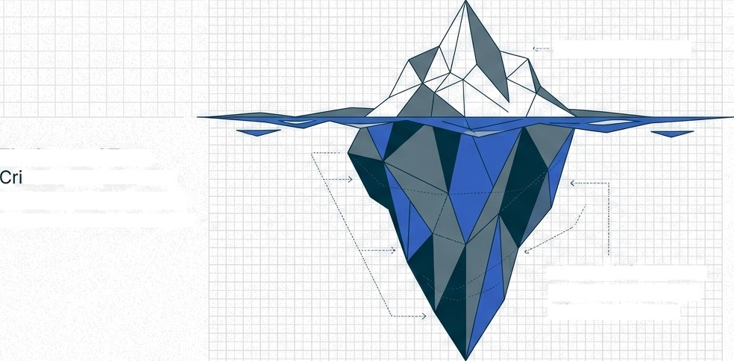
Architectural Editorial
Banque Rationale de Be|gique \ Bank van Belgie
Unmasking the UBO (Ultimate Beneficial Owner)
The Legal Entity
The Layered Trap: minals hide behind
complex, multi-layered international structures.
The Pseudo-UBO: If no UBO is found, Senior Executives are designated.
Institutions must document the measures taken and difficulties encountered.
The UBO Structure (>25% ownership or Effective Control)
G NotebookLM

Slide 8


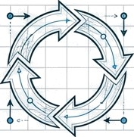


Transaction Monitoring: The Pulse of Compliance.
Stage 1
Pre-transaction
Stage 2
Post-transaction
Stage 3
Feedback Loop
Real-time stopping power (e.g., sanction hits)
Pattern recognition (e.g., ’Smurfing‘ or unusual cash use)
Backtesting & Refinement
DNB Good Practice (Backtesting):
Retrospective analysis of transactions that did NOT generate alerts (false negatives).
Analysis of rules that generate excessive false positives.
W NotebookLM

Slide 9
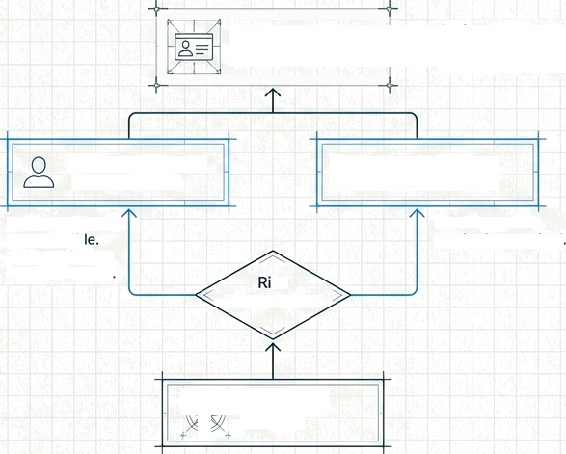
Architectural Editorial
8anque Nationals
de BeTgique
Bank van Bclgie
. ›.' ,.i
Enhanced Due Diligence: PEPs & High-Risk Countries
Senior Management Approval Framework
Senior Management Sign-Off
Senior management must sign off on high-risk relationships and
Politically Exposed Persons (PEPs)
High-Risk Third
Countries (HRTCs)
Not automatically unacceptab Requires Source of Wealth check
Strict enhanced monitoring equired
sk Identification
I Relationship
" I Initiation
W NotebaokLM

Slide 10
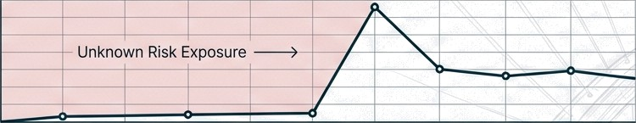



The Paradigm Shift: From Periodic to Perpetual.
The Old Way (Periodic Review)
Year 1
Year 2
Year 3
Year 4
Year 5
Potential savings by automating
the end-to-end review process
The New Way (pKYC)
(CoorplD).
Continuous Risk Management
Year 1
Year 2
Year 3
Year 4
Year 5
W NotebookLM

Slide 11


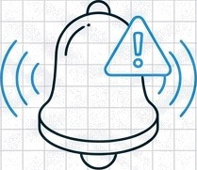

Defining Perpetual WC (pWC).
Digital Profiles
External Data Sources
Real-time Alerts
Continuous monitoring of customer profiles to validate information and identify changes immediately.
Eñiciency Gain: Moving from ’Reviewing Everyone’ to ‘Reviewing Exceptions‘ (Material Changes only).
@ Encompass
G NotebookLM

Slide 12
Six Pillars
Strong pKYC Program.
Explainability
No ”black box" Al.
Regulators must understand the algorithm.
Human Judgment
Tech reduces manual effort but does not replace oversight.
Residual Risk Management
Mitigating bad data ingestion.
Data Governance Lineage and provenance are critical.
Model Risk Management Validation ano "effective
challenge” of models.
Metrics Demonstrating effectiveness (e.g., faster alerts-to-SARs
ratio).
Source: Capgemini / Encompass
G NotebookLM

Slide 13
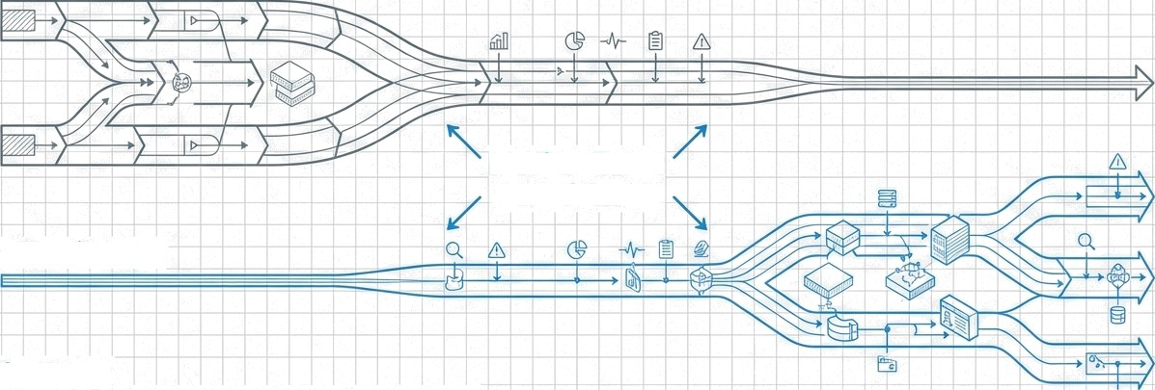
The Transition Phase: Strategic Co-Existence
Periodic Review (Legacy)
Medium Term: Co-existence
pKYC (Future)
Strategy:
Start with high-quality data segments.
Run parallel models to build trust.
Increase pKYC coverage incrementally.
@, Encompass
W NotebookLM

Slide 14





Conclusion: Compliance as Competitive Advantage
Integrity First:
Preventing financial crime,
not just satisfying regulators.
Invest in pKYC:
The solution to talent shortages and efficiency crises.
No More De-Risking: Use data to manage risk, not exclude customers.
Responsible Innovation is the expectation of the modern regulator.
G NotebookLM

